Slide 1
Introduction to Reinforcement Learning
A mini course @ HCMUS, Vietnam
Lectures 10-12 (cont’d)
Long Tran-Thanh
long.tran-thanh@warwick.ac.uk
University of Warwick, UK

Slide 2
When LLM Agents Strategically Behave

Slide 3






In this talk: NO minimal technical formulae !!!
regret minimising talk
(with some colourful slides)
Sam Taaghol
Hoang Pham
Nam Tran
Nut Srisawad
Abhimanyu Pallavi Sudhir
Sharlin Utke

Slide 4


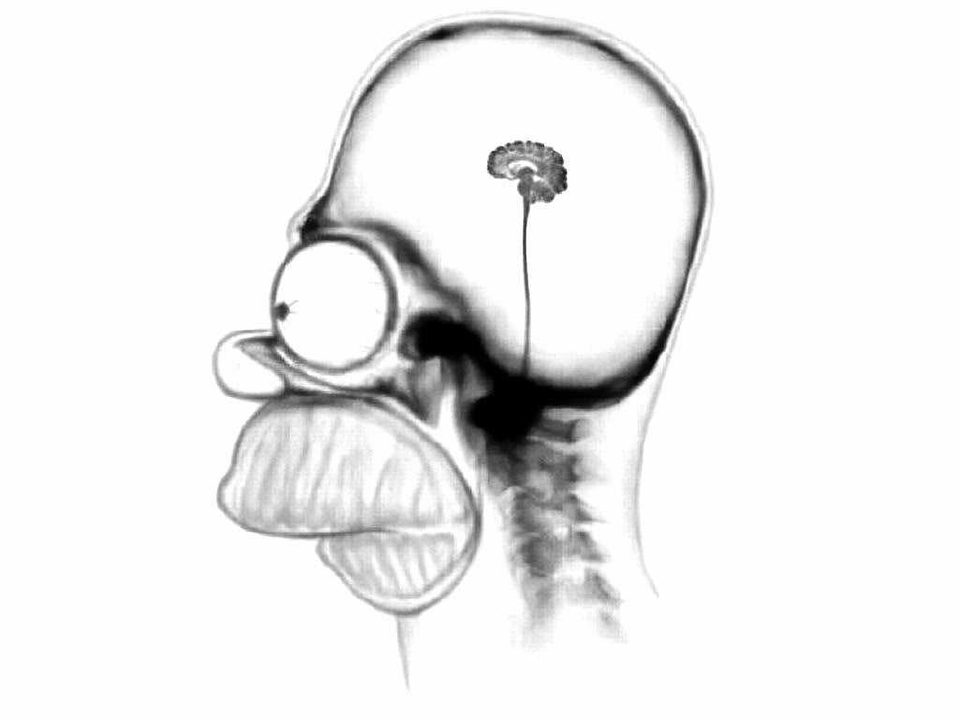
Learning Agent Model
Single-agent setting
Action
Environment
Perception
Multi-agent setting
Action
Perception

Slide 5


Future of LLM Agents
LLM Agent & Human(s)
Multi LLM Agents (+ mixed humans)

Slide 6
How Strategic Agents Behave?
Definition 1: Strategic agent = utility maximiser
Definition 2: Strategic agent = regret minimiser
Typical concept: no-regret learner (~ average regret converges to 0 over time)

Slide 7
Topics covered today
Behaviour of no-regret learners is easy to predict
Application : Last-round/last-iterate convergence in multi-agent learning
It’s easy to attack no-regret learners
Attack against bandits : attack upper and lower bounds
Attack against RL agents: the necessity of multimodal attacks
It’s easy to fool no-regret learners
Learning against deceivers and how to counteract
Learning in coopetitive games

Slide 8
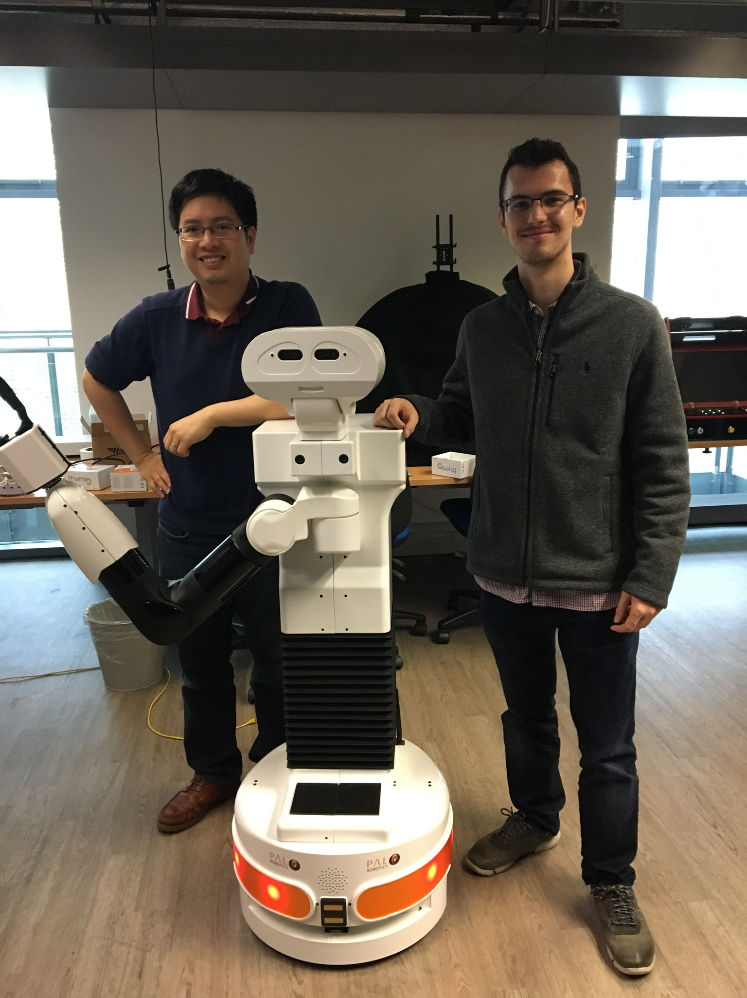
Topics NOT covered
Learning with structured data - PhD student: Nam Tran
Symmetric bandits: strict generalisation of sparsity (ECML’23, NeurIPS’24)
Learning with geometric structures (NeurIPS’24)
Deep learning:
Pruning at initialisation – PhD student: Hoang Pham (NeurIPS’23, ICLR’25)
Lifelong deep learning (CVPR’22)
Robotics:
Human-robot collaboration – PhD student: Balint Gucsi at Southampton (IROS’20, HRI’25, ICRA’25)
AI for Social Good:
E.g, wildfire mitigation (IJCAI’20), vaccine allocation (IJCAI’22), homeless housing program (AIES’18), antipoaching (IJCAI’19), etc.

Slide 9
1. Strategic learners are easy to predict
Joint work with Le Cong Dinh, Tri-Dung Nguyen, Alain Zemkoho (Southampton)
(ALT 2021, JAAMAS 2023)

Slide 10
Problem setting
Repeated 2-player zero-sum game: agent, adversary
At each t = {1,..T}: agent chooses strategy (action)
Adversary simultaneously chooses strategy
Agent observes loss and (full information feedback)
Adversary is a no-regret learner:

Slide 11
No-regret learners are easy to predict
If adversary uses no-regret learning algorithm to choose at each time step t -> Can we predict the next step of adversary without the need to observe it?
Idea: design a special algorithm (Accurate Follow the Regularized Leader) and play against the adversary
Key result: We show that -> use to predict (we assume we
observe adversary’s move after we have made our own)

Slide 12


Application: last-round convergence in multi-agent systems
Selfish behaviour causes system collapse:
Piatti et al., Arxiv’24 (e.g., financial system’s collapse)

Slide 13
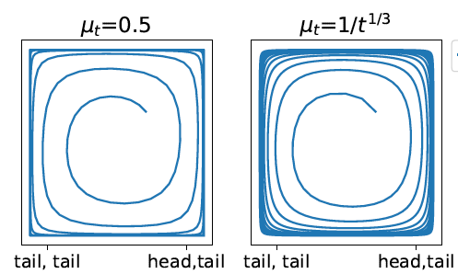
Impossibility results
Repeated Matching Pennies after 2500 iterations:
No-regret learning alg: Multiplicative Weight Update
Blue line: MWU vs MWU
System dynamics: outward spiral -> no convergence
Known since Mertikopoulos, Papadimitriou & Piliouras (2018): no last round convergence in general case. Other notable work: Bailey and Piliouras (2018), Cheung and Piliouras (2019)
Existence of last round convergence – some special cases:
Daskalakis and Panageas (2018): Optimistic MWU + unique minimax equilibrium
Bu, Ratliff & Mesbahi (2019): Differential games (linear-quadratic) + gradient ascent/descent
Goktas & Greenwald (2022): Exploitability-minimising strategy profiles

Slide 14
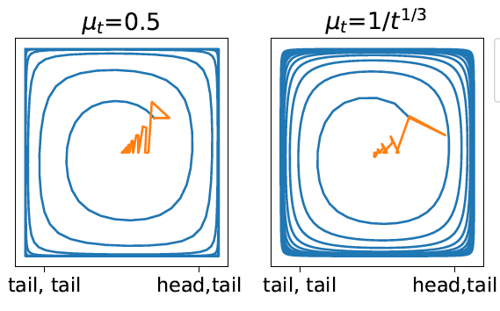
Last-round convergence with asymmetric knowledge (Dinh et al., ALT 2021)
Asymmetric information:
Leader (column player) can estimate her (approximate) minimax strategy
Follower (row player) is a regret minimiser -> uses a no-regret algorithm
Leader’s objectives:
Last round convergence
Provable performance guarantee (e.g., no-regret)
Main result: Column player uses LRCA and row player chooses from a large class of no-regret algorithms (including FTRL-class) -> last round convergence + column player achieves no-instant-regret

Slide 15
2. It’s easy to attack no-regret learners
Joint work with and Sam Taaghol (Warwick), Shivakumar Mahesh (Warwick/Oxford), Anshuka Rangi (UCSD/Amazon), Haifeng Xu (UChicago) and Massimo Franceschetti (UCSD)
(AAAI’22, IJCAI’22, ICML’25 submission)

Slide 16


Exploration vs. exploitation
Trade-off
Exploration = learning the model
Exploitation = optimising over learnt model
(learn the reward values)
(optimise the rewards over time)
Too much exploitation: not enough information -> suboptimality
Too much exploration: not enough time to optimise -> suboptimality

Slide 17
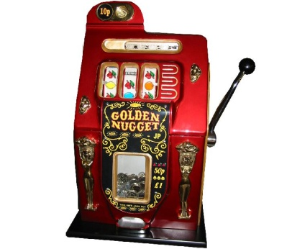
The multi-armed bandit (MAB) model
There are multiple arms
At each time step (round):
We choose 1 arm to pull
Receive a reward, drawn from an unknown distribution of that arm
Objective: maximise the expected total reward
Exploration: we want to learn each arm’s expected reward value
Exploitation: we want to maximise the sum of the rewards
MAB is the simplest (and flexible) model that captures the dilemma of exploration vs. exploitation

Slide 18

Attack on bandits
Attacker objective:
To induce linear regret
(i.e., to violate the no-
regret property)
Decision making
Perception
Environment
Behaviour/Action

Slide 19
Characterisation of attackers
Strength of attackers
Weak attacker: makes contamination each time step before observing the pulled action
Strong attacker: makes contamination each time step after observing the pulled action
Contamination budget bounds
Bounded above surely by a threshold (deterministic budget)
Bounded above in expectation (expected budget)

Slide 20
How easy to attack the bandit models?
Assumption: bandit algorithm is oblivious to the attack
Question 1: How much contamination is needed to succeed (i.e., to induce linear regret)?
Answer: typically O(logT) attacks is sufficient to succeed
Question 2: What is the minimum contamination needed to succeed?
Existing work: no lower bound. Conjecture: strong attacker needs less than weak one
Our work:
Weak = strong attacker (in most cases)
First attack lower bounds (using notion of conservativeness)

Slide 21
Attacking Episodic RL agents
Episodic RL = bandit with state transitions
Multimodality of attacks: adversary can contaminate reward, state transition, action (or combination of these)
Result 1 (Rangi et al., IJCAI’22): Single mode attacks are not feasible in bounded reward settings (i.e., rewards are between 0 and 1)
Result 2 (Rangi et al., IJCAI’22): Reward + action manipulation needs contaminations

Slide 22
Defence against these attacks
Question 1: how to design attack-aware bandit algorithms to mitigate the attack
Setting: Deterministic contamination budget C
(no results on expected budget to date)
 | Strong attacker | Weak attacker
Regret upper bound | (Bogunovic et al. 2020) | (Gupta, Koren, and Talwar 2019)
Regret lower bound
Question 2: Can we go below the lower bound of C?

Slide 23
Saving bandits with verification: unlimited version
Agent’s objective: Minimise the number of verifications required to restore the logarithmic regret bound.
Theorem 2: Lower Bound (Rangi et al., AAAI’22)
Remark: This lower bound is tight and can be achieved by multiple verification algorithms

Slide 24
Saving bandits with verification: limited version
Agent’s objective: Minimise the regret if the number of verifications are bounded by at most B.
Motivation: If B=0, then the regret scales at least , where C is the amount of contamination.
Question: If B>0, then can we do better then this lower bound of ?
Answer: Yes.

Slide 25
Regret upper bound for verification with limited budget
Theorem 3: Upper Bound (Rangi et al., AAAI’22)
Remark: This is a tight upper bound (i.e.., there’s a matching lower bound)

Slide 26
3. Learning against strategic manipulators (i.e., deceivers)
Joint work with Jiarui Gan, Nick Bishop (Oxford)
Qingyu Guo, Bo An (NTU)
Enrico Gerding (Southampton)
(NeurIPS’19, ACM EC’19, NeurIPS’20)

Slide 27
Motivation
LLM agents can exploit each other:
Deceive their human users/fellow agents (e.g., to steal their money) (Scheurer et al., ICLR workshop’24)

Slide 28
Learning with strategic manipulators
2-player general-sum game
Setting description:
Manipulator aims to maximise their (unknown) utility function
Manipulator can modify the observation of the learner (data, payoff, etc)

Slide 29
Mimicking zero-sum game is the best for the manipulator (Gan et al., NeurIPS 2019)
2-player non-zero-sum security games
Opponent can lie about their type (e.g., type = payoff parameters) to fool us, but we can also see
the reported payoff of the opponent
Question: what manipulation would benefit the opponent the best
Brain teaser: which one is better?
Playing zero-sum game, but pretend that you are not vs.
Playing non-zero sum game, but pretend that you are full adversary (i.e., play a zero-sum game)
Theorem (informal): The best strategy for the manipulator is to pretend to play a zero-sum game (i.e., we are back to the minimax optimisation problem in the worst-case)

Slide 30
Counteracting this manipulator (Gan et al., NeurIPS 2019)
The previous result holds if the defender (a.k.a. we) are oblivious to the manipulation
If we are aware to the fact of manipulation: We can do better than solving the minimax problem
Policy: Set of rules that determines what to play against each reported type (aka payoff matrix)
Stackelberg (a.k.a. leader-follower) model: We first announce our policy, then the opponent makes the best response (i.e., compute the best lie)
Main result: The optimal policy can be calculated in polynomial time, and the resulted solution is strictly better than that of the minimax problem in many cases.

Slide 31
4. Coopetitive setting
Joint work with Shivakumar Mahesh (Warwick/Oxford), Nick Bishop (Oxford), Le Cong Dinh (Southampton)
(GameSec’23, Arxiv)

Slide 32

What’s coopetitive game?
In order to win/perform well, one must cooperate with their opponents
But they also need to know when to stop cooperating to become the winner/achieve their goal
That is, they need to cooperate and compete at the same time (Nalebuff & Brandenburger, 1996)
https://cruciformstuff.com/2023/07/30/betrayal/

Slide 33

Example 1: Blue-Ray vs. DVD
https://fr.tipard.com/resource/blu-ray-vs-dvd.html

Slide 34
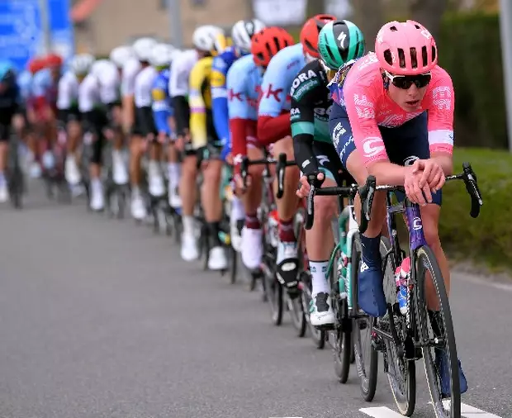
Example 2: Tour de France
https://www.ef.fr/blog/language/les-principaux-termes-de-cyclisme-connaitre-pour-regarder-le-tour-de-france/

Slide 35
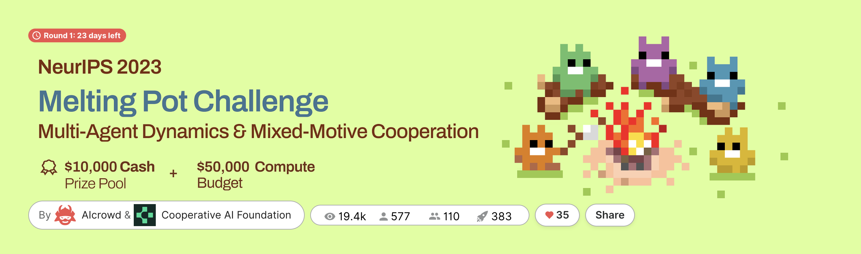
Recent interests from the AI Community
Google Deepmind + Cooperative AI Foundation’s Melting Pot Challenge (hosted at NeurIPS 2023)
https://www.aicrowd.com/challenges/meltingpot-challenge-2023

Slide 36
Research questions
In AI, we consider a multi-agent sequential decision-making version of coopetitive games:
Who to cooperate with?
How to signal/incentivise others to collaborate
When to switch side?

Slide 37
Our focus
Aim: Proof of Concept
Simplified setting
3 players
Repeated games
Polymatrix games
Signaling: payoff manipulation

Slide 38
Payoff manipulation explained
In our setting no explicit communication between agents is allowed
Instead, we allow one agent to modify another agent’s payoff by:
Sacrificing from their own payoffs (e.g., gift, bribery, etc) -> increasing the other’s payoff
Enforce some penalties -> decreasing opponent’s payoff
Examples: multiplayer video games, nature, etc.

Slide 39
Main Results (Mahesh et al., GameSec 2023)
(Informal) We prove that the manipulating agent can learn to manipulate with minimal cost to win the games
Applied to iterated prisoners’ dilemma: can manipulate opponents to cooperate, while we can still defect them
And many more results: https://arxiv.org/abs/2110.13532

Slide 40
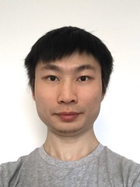

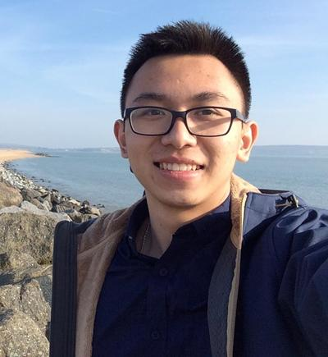
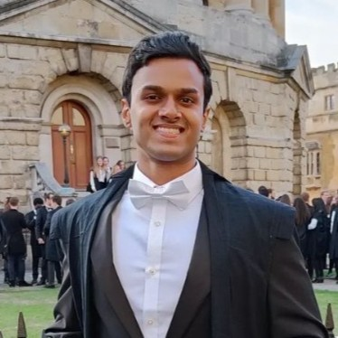

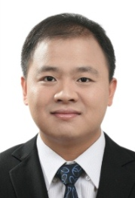

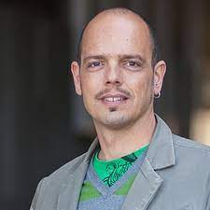
Many thanks for your attention
Jiarui Gan
Nick Bishop
Le Cong Dinh
Shiva Mahesh
Anshuka Rangi
Bo An
Mike Wooldridge
Massimo Franceschetti

